Slide 1
SESSION -4
ELIMINATION METHOD

Slide 2
Dear students, let us now learn yet another method of solving a system of equations algebraically.
This method is called the Elimination Method. As the name suggests, here we eliminate one of the variables so as to obtain a linear equation in just one variable which we all can solve easily.

Slide 3
Let us consider this example
Solve 3x – 5y – 4 = 0 and 9x = 2y + 7
Solution: The given equations can be re-written as
3x - 5y = 4 ------------(1)
9x – 2y = 7 -----------(2)
We need to eliminate one of the two variables
i.e. either x or y needs to be removed so as to obtain a linear equation in one variable.
Let us get rid of x say.
Then, we will have to make the coefficient of x same in both the equations and then add or subtract the equations depending on the signs of the coefficients of x.
I would now illustrate how we can do this.
In order to make the coefficients of x same in (1) and (2), we need to multiply (1) by 3.

Slide 4
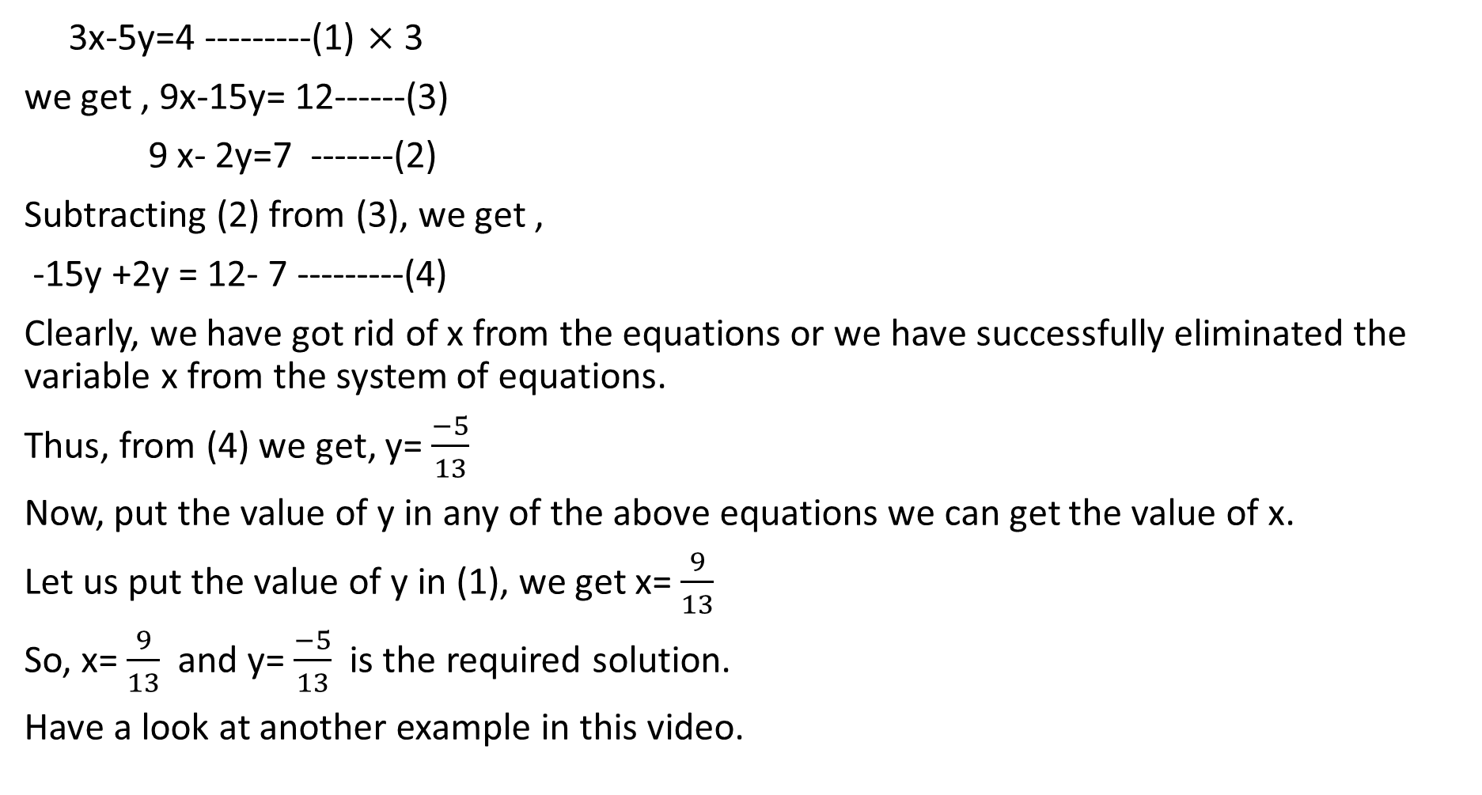
3x-5y=4 ---------(1) $×$3
we get , 9x-15y= 12------(3)
9 x- 2y=7 -------(2)
Subtracting (2) from (3), we get ,
-15y +2y = 12- 7 ---------(4)
Clearly, we have got rid of x from the equations or we have successfully eliminated the variable x from the system of equations.
Thus, from (4) we get, y= $\frac{−5}{13}$
Now, put the value of y in any of the above equations we can get the value of x.
Let us put the value of y in (1), we get x= $\frac{9}{13}$
So, x= $\frac{9}{13}$ and y= $\frac{−5}{13}$ is the required solution.
Have a look at another example in this video.

Slide 5


Slide 6
The example solved for you in the slide before the video was Q1 (iii) (Ex 3.4), now do the rest of the parts yourself in your class work notebook.
Let us now discuss a few parts from Q2 of Ex 3.4
Q2 (iii) The sum of the digits of a two-digit number is 9. Also, nine times this number is twice the number obtained by reversing the order of the digits. Find the number
Solution: Let the digit at the ones place be x and the digit at the tens place by y.
Then the number , in its expanded form is given by 10y+x.
So, the number obtained by reversing the digits of the above number in its expanded form can be written as 10x+y.
According to the question, we have,
x+y=9------------------(1)
9(10y+x)= 2(10x+y)
i.e. 90y+9x-20x-2y=0
i.e. 88y- 11x=0
Or 8y-x=0-------------(2)

Slide 7
Let us now solve these equations,
We have
x+ y =9---------(1)
-x+8y=0--------(2)
Adding (1) and (2), we successfully eliminate the variable x and get
9y=9 i.e. y=1
Putting the value of y in (1) we get, x=8.
Therefore, the required number is 10y+x= 10+8= 18.

Slide 8
Let us solve another word problem using elimination method.
Ex 3.4, Q2 (iv) Meena went to a bank to withdraw ₹ 2000. She asked the cashier to give her ₹ 50 and ₹ 100 notes only. Meena got 25 notes in all. Find how many notes of ₹ 50 and ₹ 100 she received.
Solution: Let the number of ₹100 notes be x that of ₹50 notes by y.
Then according to the question,
x+y=25----------(1) and
100x+50y= 2000
Or 2x+y=40-------(2)
Subtracting (2) from (1) we get,
-x = - 15 or x=15
Substituting the value of x in (1) we get y= 10.
Thus, number of ₹100 notes is 15 and that of ₹50 notes is 10.

Slide 9
Note: Complete the rest of the parts of the question on your own in the classwork notebook.
With this we end the fourth worksheet Ex 3.4
Take a few practice questions now. (From Assignment)
1. The sum of a two digit number and the number formed by reversing its digits is 110. If 10 is subtracted from the number, the new number is 4 more than 5 times the sum of the digits in the original number. Find the number. [CBSE 2017]
2. In a function if 10 guests are sent from room A to B, the number of guests in room A and B are same. If 20 guests are sent from B to A, the number of guests in A is double the number of guests in B. Find number of guests in both the rooms in the beginning.

